Slide 1
Anthony and Dorian
English slideshow

Slide 2



Fight hunger

Slide 3
Sommary
What is Oxfam
Some details about Oxfam
How to acces oxfam
Conclusion
The end

Slide 4




Oxfam

Slide 5


Oxfam
In the world :
19 Oxfam affiliatest
10,000 employees
100,000 volunteers and thousands of partners
In France :
25,000 donors.
200,000 people

Slide 6
How to access Oxfam
Participate in one of the Trailwalkers (100 km 1 Week end)
Join a local group ( 1year)
Join Oxfam's Digital Activists Group (10 MIN)
Become a volunteer, once a week (4 h)

Slide 7
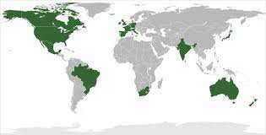

The end
Thanks for your attention

